Slide 1

Spatial Data: Crawling, Metadata Discovery, Publishing & Query Orchestration
M.Tech. Thesis Presentation
Submitted by
Deepak Punjabi
15IT60R17
Under Guidance of
Prof. Soumya K. Ghosh

Slide 2
Introduction
Definitions & Terminology
Notes:
Now lets see why do we need spatial data
And how it can be useful to us

Slide 3

Spatial Data
Spatial data
is data containing Information about
the locations and shapes
of geographic features
and the relationships between them,
usually stored as coordinates and topology.
Source: http://support.esri.com/
Notes:
First we need to understand what is spatial data.
Type of spatial data

Slide 4
Spatial Data Types
Geometry
Point
Curve
Surface
GeomCollection
LineString
Polygon
MultiSurface
MultiCurve
MultiPoint

Slide 5
Spatial Web Services
Web Map Service (WMS)
Open
GeospatialConsortium
(OGC)
Web Feature Service (WFS)
Web Coverage Service (WCS)

Slide 6
Problem Statement
Defining the problem
Motivation
Defining the solution objectives
Solution Model

Slide 7
Aim
Create a foundation platform
to crawl, store, maintain, and publish
metadata information about spatial data
and it’s providers and to utilize this information
to perform efficient query orchestration.

Slide 8
Motivation
Use Cases:
Challenges
Remote Sensing
Area affected by flood/disease
Spatial-Temporal analysis
Spatial data mining
Telecom & Network Services
Urban Planning and Hot spot analysis
Navigation
And many more…
Availability: not all spatial data is publicly available
Current Solutions: Available search engines do not handle spatial data efficiently
Heterogeneity: Spatial data has complex data types and operations

Slide 9
Objectives
Build a topical crawler to crawl the web and store geo-spatial metadata.
Build an Open Geospatial Consortium (OGC) compliant catalog service to publish and search accumulated metadata.
Build Query orchestration service to perform real-time query with heterogeneous data sources and cost matrices associated with them.

Slide 10
Solution Model: 3 stage approach
1
Spatial Web Crawler
2
Catalog Service
3
Query Processing

Slide 11
Spatial Web Crawler
Objectives
Architecture
Notes:
Now lets see why do we need spatial data
And how it can be useful to us

Slide 12
Spatial web crawler: Objectives
Build a spatial web crawler which crawlers through geo-servers which offers Web Feature Service(WFS) based OGC compliant services.
Build a domain specific vocabulary(ontology) for this features which can be helpful to compare found features with wanted features.
Perform semantic matching of found features from crawled web-pages with given ontology for filtering the correct features and storing them in the permanent repository.

Slide 13
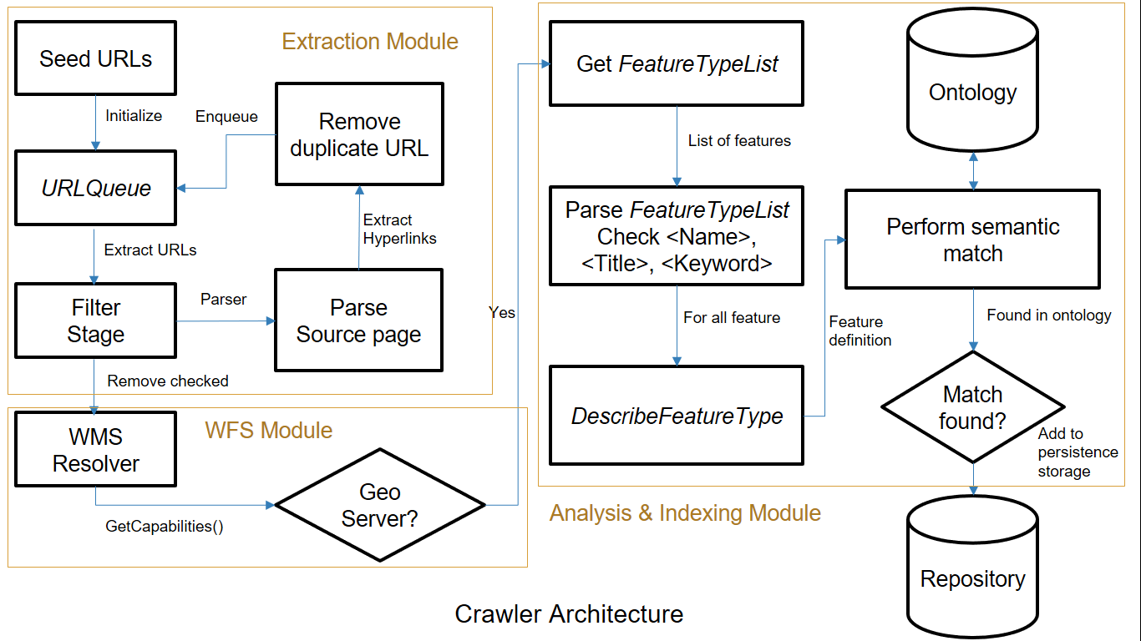
Spatial web crawler: Architecture

Slide 14
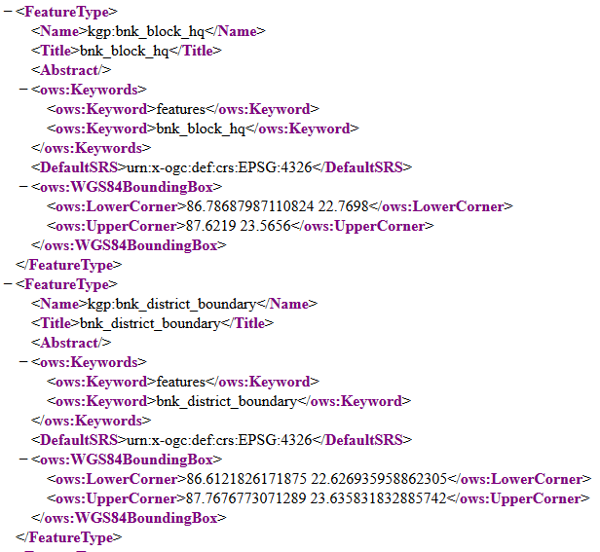
WFS Capabilities

Slide 15
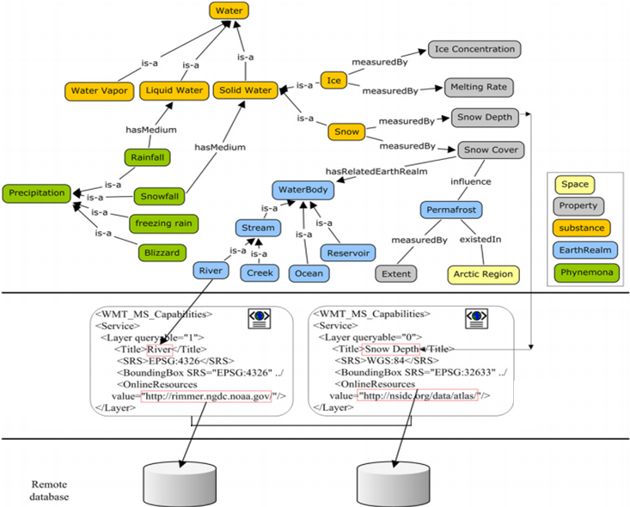
source: Li, W., et al. Computers & Geosciences,2011.

Slide 16
Spatial Catalog Service
Objectives
Architecture
Notes:
Now lets see why do we need spatial data
And how it can be useful to us

Slide 17
Spatial Catalog Service: Objectives
Parse the crawled metadata and store it into a permanent database in a structured manner.
Parse the crawled metadata and store it into a permanent database in a structured manner.

Slide 18
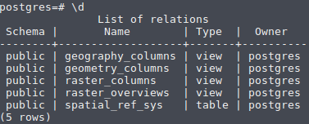
Architecture: Spatial Catalog Service
Catalog
Server 1
Manual Addition
For known
Geo-Repositories
Interfaces for external
Applications & Services
Spatial Web Crawler
Spatial
Repository 1
Directory of
XML files
Capabilities.xml
GetCapabilities()
Spatial
Repository n
Catalog
Server
PyCSW
Parser
load_records
Database
setup_db
PyCSW
PostgreSQL
WSGI server

Slide 19
Design Choices
PyCSW:
GeoServer:
Stores metadata information
Less resource intensive
Provides APIs for spatial web services
Stores metadata information as XML files.
Two step delivery for data queries
Can store data as well as metadata information
More resource intensive
Provides graphical admin panel and APIs for spatial web services
Supports more file formats like XML, GML for metadata & shape for data
Can directly response with data
Provides extensions

Slide 20
PyCSW Query Processor
Database holds all metadata information about the data available from repositories.
Type of queries
Metadata Query
Request for the data object
Request 1: GetLayerNames()
Metadata Query
Catalog
Server
Response
Request 2: GetMap()
Data Query
GetMap()
Rep 1
Response image
Map object

Slide 21
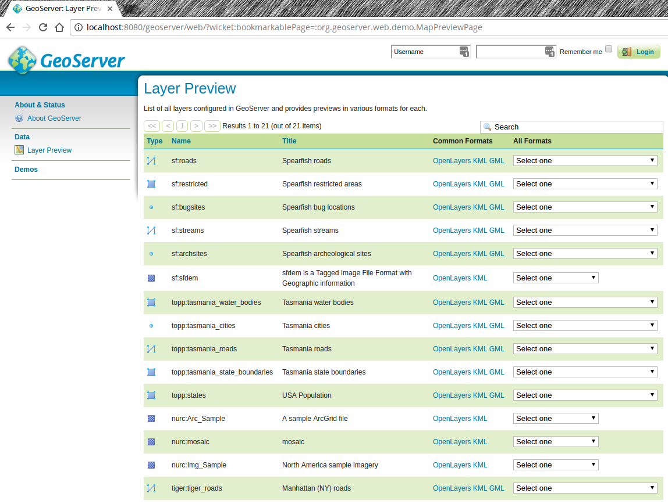

Slide 22
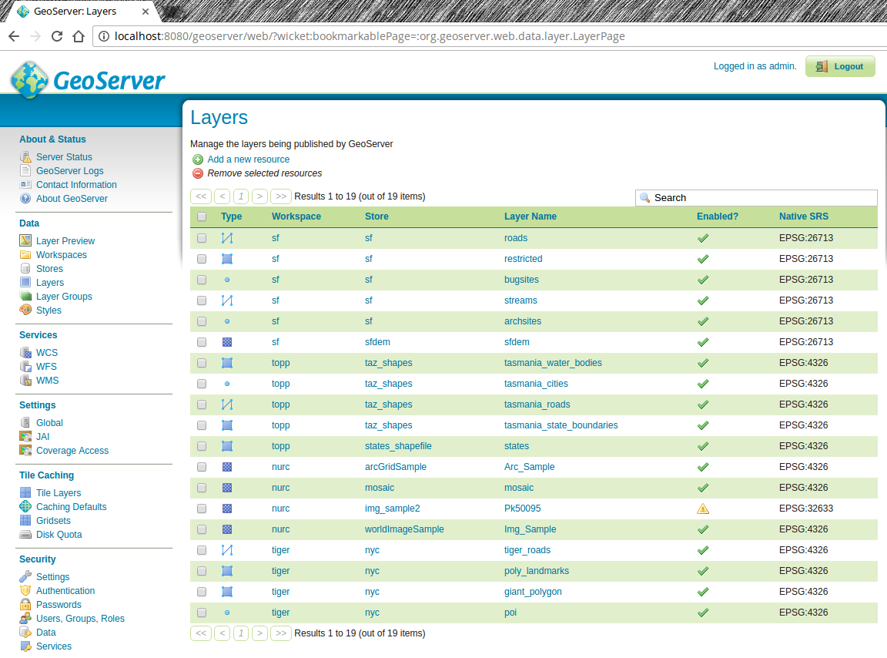

Slide 23
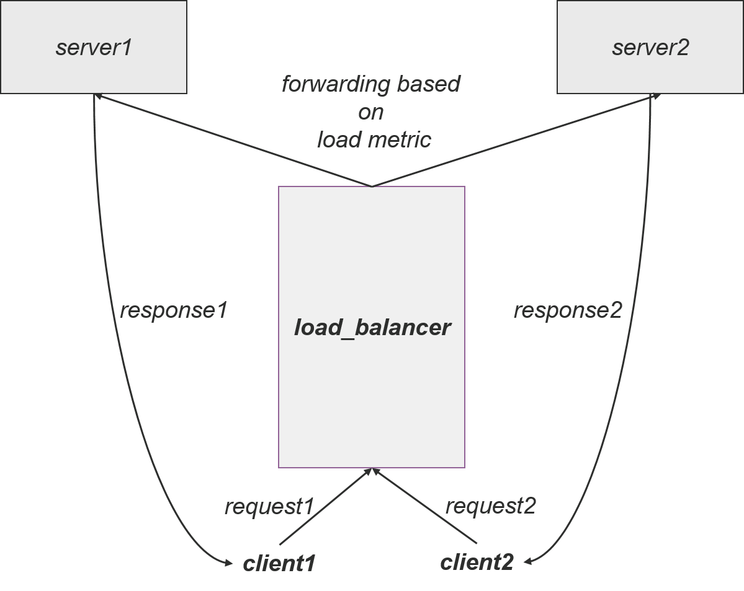
Extending to Cloud Characteristics
Load Balancer:
Higher Availability
Horizontal Scaling
Middleware or Gateway
Access Control

Slide 24
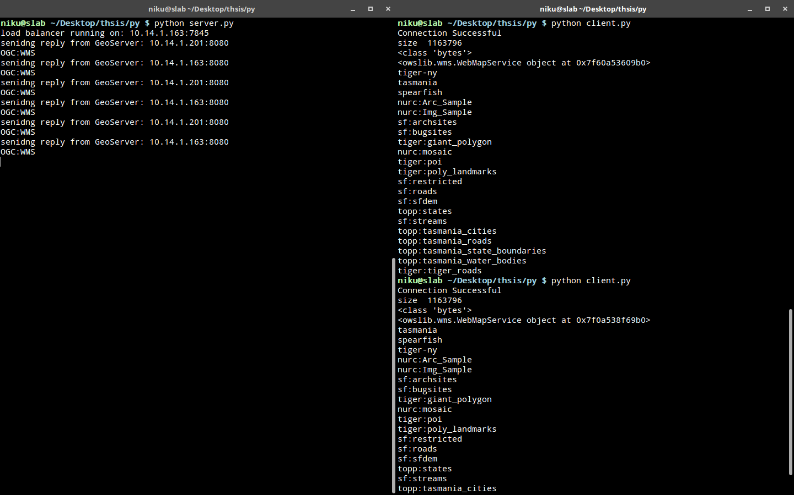

Slide 25
Results
List of available Layers:
List of available Operations
kgp:POPULATION
kgp:bnk block boundary
kgp:bnk block hq
kgp:bnk district boundary
kgp:bnk drainage
kgp:bnk grampanchayat boundary
kgp:bnk mouza boundary
kgp:bnk road
GetCapabilities
GetMap
GetFeatureInfo
DescribeLayer
GetLegendGraphic
GetStyles

Slide 26
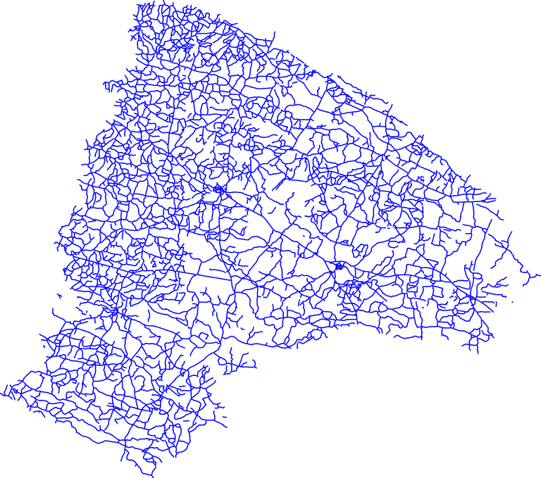
GetMap
GetMap returns a map image of the layer(s) in available formats.
Options:
Layers=kgp:bnk_road
Width=768
Height=679
Format=image/png

Slide 27

DrawMap
DrawMap Overlays different map images on top of each other.
Useful to find affected area.
Options:
Layers = { kgp:bnk_road, kgp:bnk_block_hq, kgp:bnk_block_boundary }
Width = 768
Height = 679
Format = image/png

Slide 28
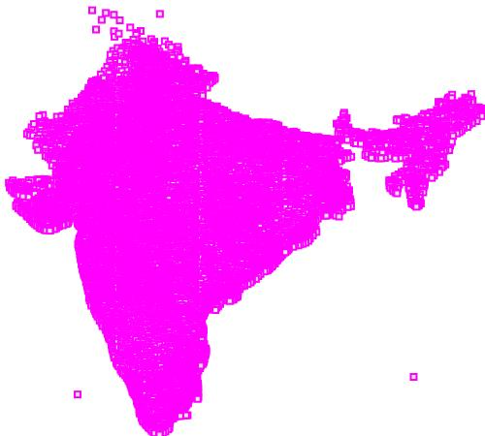
Information about specific layer *
Title | POPULATION
Name | kgp:POPULATION
Is Queryable | 1
Is Opaque | 0
Bounding Box |
minx | 68.52669525146484
miny | 8.086045265197754
maxx | 97.3387680053711
maxy | 35.8697509765625
* This image shows population density in India,
without any information on boundaries.

Slide 29
Spatial Query Orchestration
Applications of spatial data
Problems with currently available solution
Notes:
Now lets see why do we need spatial data
And how it can be useful to us

Slide 30
Quadtree based Indexing
Quadtree is a special kind of data structure used for spatial division.
Each node has 4 child nodes.
Most commonly used indexing technique in Quadtree is Z-order.
Naive technique for indexing
Notes:
//Cloud based approach provides higher availability, scalability, and better version control without needing to shutdown the system to implement changes.

Slide 31
Ranking by Quality Preferences
Quality preferences can be used for ranking when extra information about the spatial neighborhood is available.
In this type of ranking, the total score of a feature depends on quality of its spatial neighborhood.
E.g. Purchasing a house
Many type of mathematical qualities can be applied to find quality of neighborhood like sum, average for each or all feature type.
Notes:
//Cloud based approach provides higher availability, scalability, and better version control without needing to shutdown the system to implement changes.

Slide 32
(80,80)
80
x1 (2)
x2 (5)
y2 (5)
y3 (1)
60
feature2
feature4
y1 (3)
y4 (4)
40
x3 (4)
x4 (8)
x6 (6)
y5 (2)
20
feature1
feature3
x5 (3)
y6 (7)
(0,0)
20
40
60
80

Slide 33
(80,80)
80
x1 (2)
x2 (5)
y2 (5)
y3 (1)
60
feature2
feature4
y1 (3)
y4 (4)
40
x3 (4)
x4 (8)
x6 (6)
y5 (2)
20
feature1
feature3
x5 (3)
y6 (7)
(0,0)
20
40
60
80

Slide 34
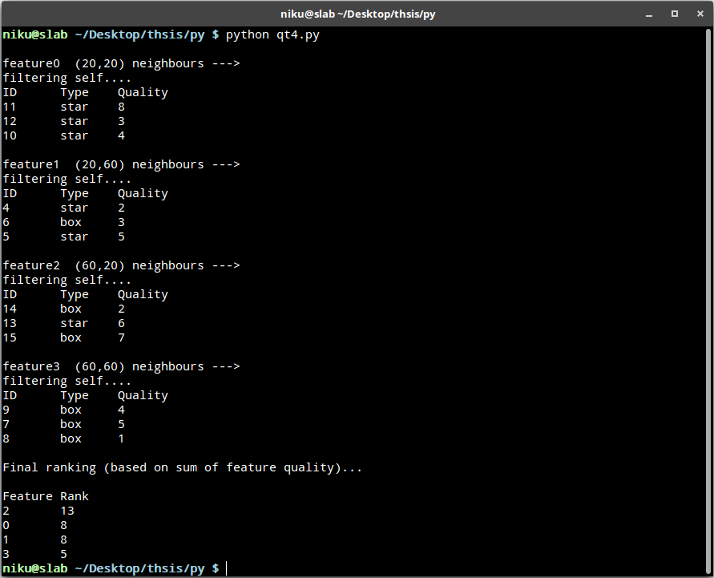

Slide 35
Conclusion
Geo-service portal acts as a underlying framework or foundation for various kind of higher level use cases.
Building an OGC compliant web service catalog can also be beneficiary as already available software and services can use the registry for various kinds of services with little to no modification of their original code-base.

Slide 36
Future Scope
Build a cloud based implementation for the spatial web crawler, catalog service and query processing.
Build interfaces and implementation for more complex queries.
Provide parallel query processing for same data occurring in multiple repositories.
Notes:
//Cloud based approach provides higher availability, scalability, and better version control without needing to shutdown the system to implement changes.

Slide 37
References
Sonal Patil, Shrutilipi Bhattacharjee, and Soumya K. Ghosh. A spatial web crawler for discovering geo-servers and semantic referencing with spatial features. International Conference on Distributed Computing and Internet Technology. Springer International Publishing, 2014.
Li, Wenwen, Chaowei Yang, and Chongjun Yang. An active crawler for discovering geospatial web services and their distribution pattern. A case study of OGC Web Map Service. International Journal of Geographical Information Science 24.8 (2010): 1127-1147.
Ahlers, Dirk, and Susanne Boll. Location-based Web search. The Geospatial Web. Springer London, 2009. 55-66.
Li, W., et al. Semantic-based web service discovery and chaining for building an Arctic spatial data infrastructure. Computers & Geosciences 37.11 (2011): 1752-1762
https://github.com/karimbahgat/Pyqtree
Paul, Manoj, and S. K. Ghosh. An approach for service oriented discovery and retrieval of spatial data. In Proceedings of the 2006 international workshop on Service-oriented software engineering, pp. 88-94. ACM, 2006.
Notes:
//Cloud based approach provides higher availability, scalability, and better version control without needing to shutdown the system to implement changes.

Slide 38
References (continue)
Jiang, Jun, Chong-jun Yang, and Ying-chao Ren. A Spatial Information Crawler for OpenGIS WFS. Sixth International Conference on Advanced Optical Materials and Devices. International Society for Optics and Photonics, 2008.
http://geopython.github.io/pycsw-workshop/
https://geopython.github.io/OWSLib/
Lopez-Pellicer, Francisco J., et al. Discovering geographic web services in search engines. Online Information Review 35.6 (2011): 909-927.
https://github.com/geoserver/geoserver
Yiu, Man Lung, Hua Lu, Nikos Mamoulis, and Michail Vaitis. Ranking spatial data by quality preferences. IEEE Transactions on Knowledge and Data Engineering 23, no. 3 (2011): 433-446.
Hjaltason, Gisli, and Hanan Samet. Ranking in spatial databases. In Advances in Spatial Databases, pp. 83-95. Springer Berlin/Heidelberg, 1995.
Notes:
//Cloud based approach provides higher availability, scalability, and better version control without needing to shutdown the system to implement changes.

Slide 39
Thank You

